Slide 1
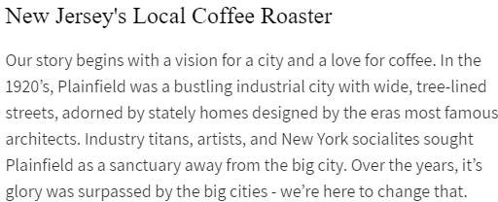

Slide 2
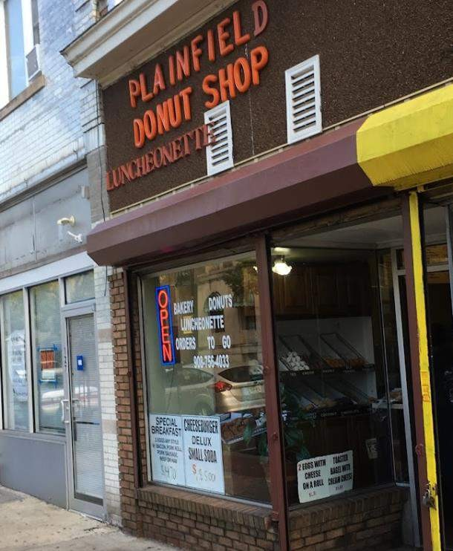
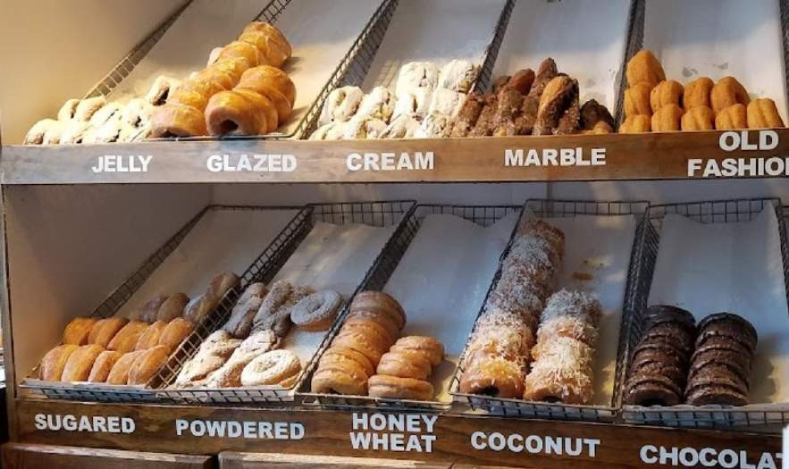

Slide 3
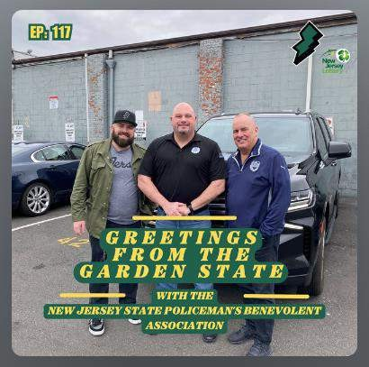
Greeting From The Garden State
Humans Behind the Badge:
The NJSPBA and New Jersey Donuts
https://www.greetingsfromthegardenstate.com/

Slide 4
Cyber Security Tips for a Safer 2024
Steve Flood
February 20 Plainfield Chamber Mtg
©2024 – Scomage Information Services, Inc.

Slide 5
(1) Be Informed!
Be Aware!
US Virus Alerts (CISA)
https://www.cisa.gov/news-events/cybersecurity-advisories
NJ Virus Alerts (NJCICC)
New Jersey Cybersecurity and Communications Integration Cell
https://www.cyber.nj.gov/threat-center/alerts-advisories/

Slide 6
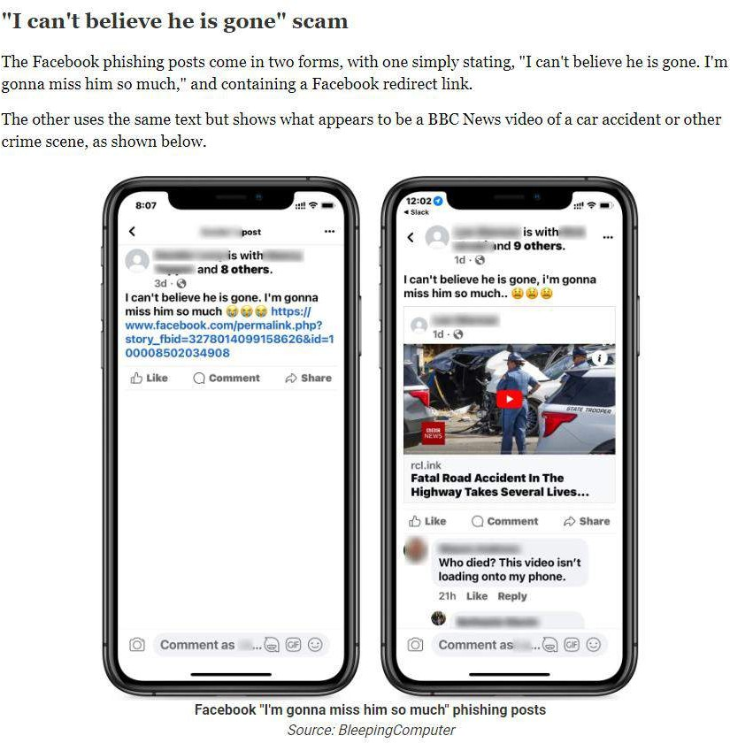
Be Aware!
Be Informed!

Slide 7
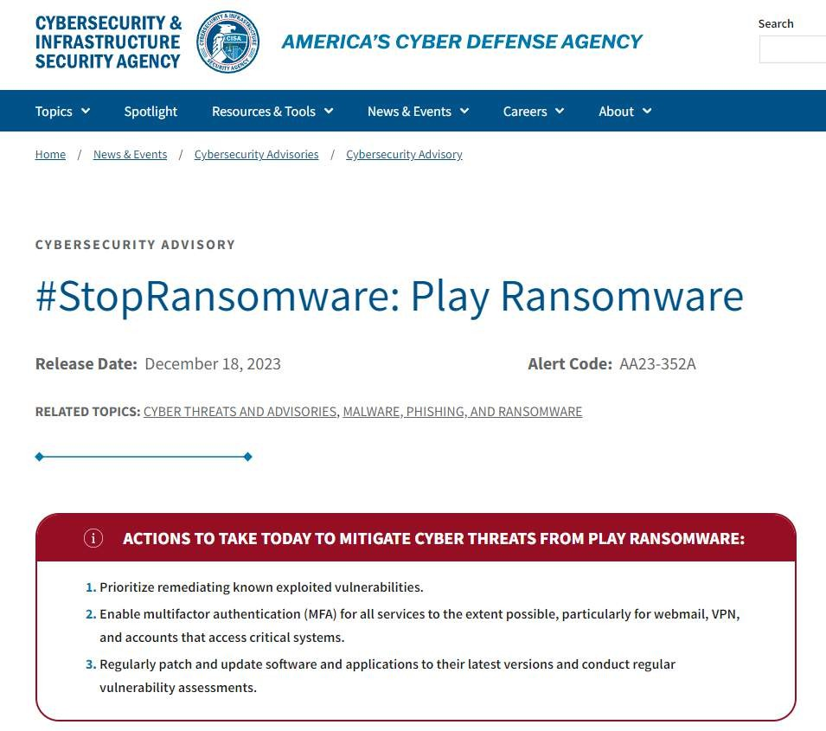
Be Aware!
Be Informed!

Slide 8
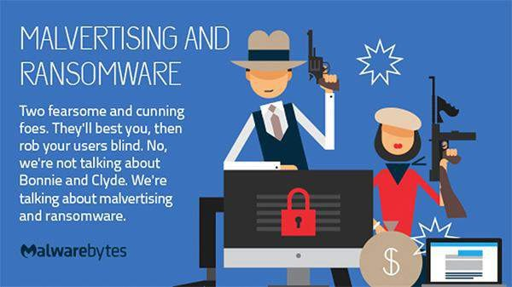
Ransomware

Slide 9
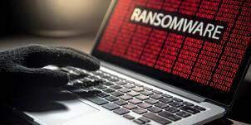
Ransomware
Ransomware - a type of malicious software that threatens to publish the victim's data or perpetually block access to it unless a ransom is paid.
According to Microsoft - 80-90% of ransomware attacks over the past year originated from unmanaged devices https://www.theregister.com/2023/10/05/microsoft_byod_ransomware/

Slide 10
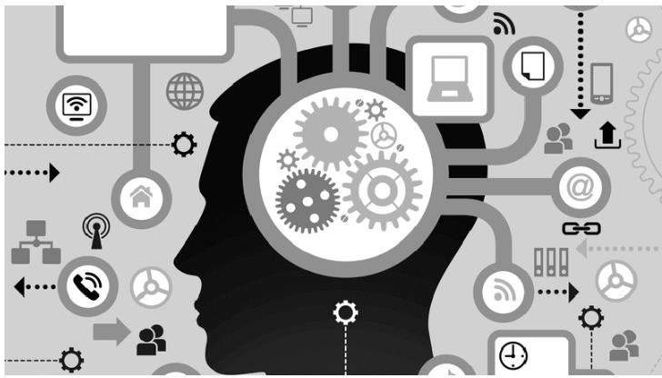
Phishing and Social Engineering
Social engineering attacks typically involve some form of psychological manipulation,
fooling otherwise unsuspecting users or employees into handing over confidential data.
https://www.tripwire.com/state-of-security/5-social-engineering-attacks-to-watch-out-for

Slide 11
(2) Check Your Email for Breaches
According to Microsoft - 80-90% of ransomware attacks over the past year originated from unmanaged devices
https://www.theregister.com/2023/10/05/microsoft_byod_ransomware/
Have I Been Pwned?
Have I Been Breached?
https://haveibeenpwned.com/ https://haveibeenbreached.com/

Slide 12
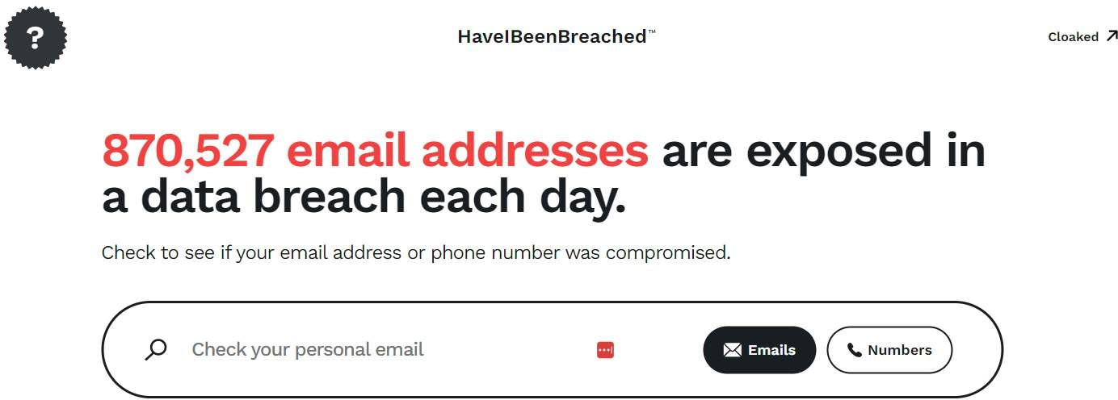
Check Your Email For Breaches

Slide 13
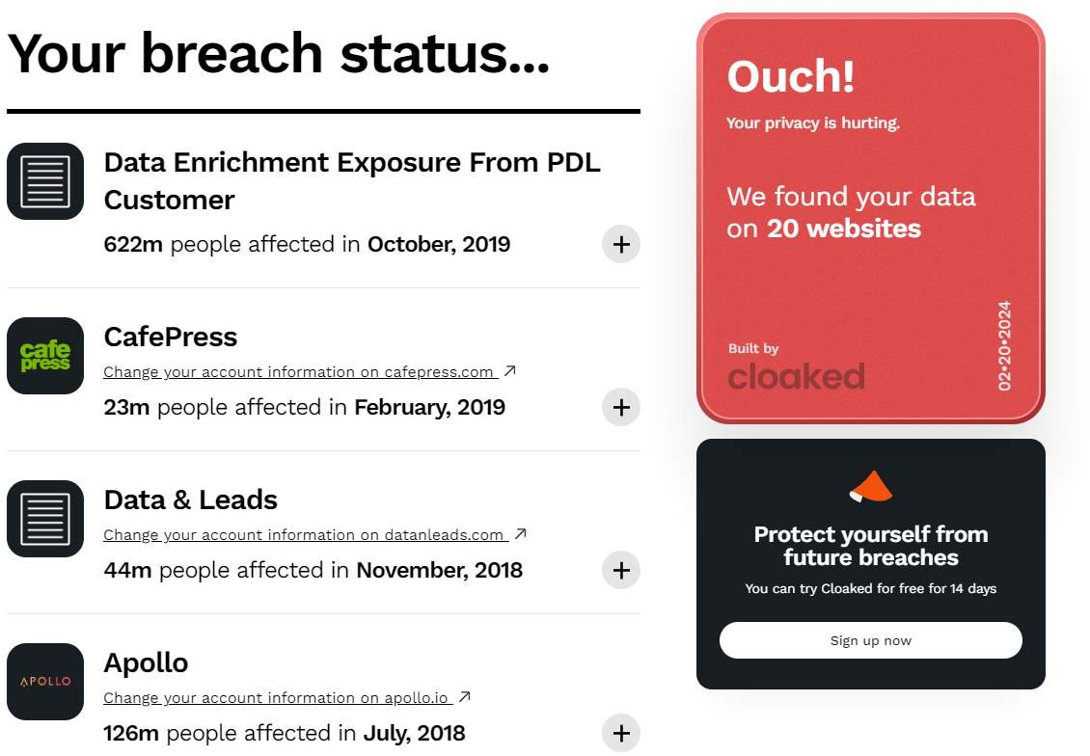
Check Your Email For Breaches

Slide 14
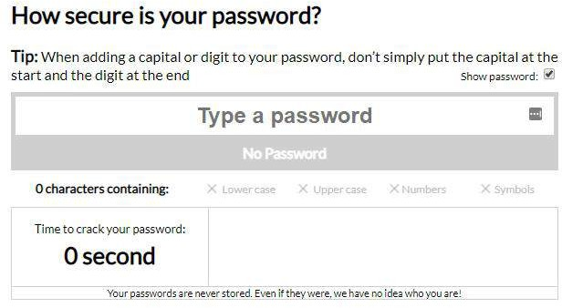
(3) Choose Safe Passwords

Slide 15
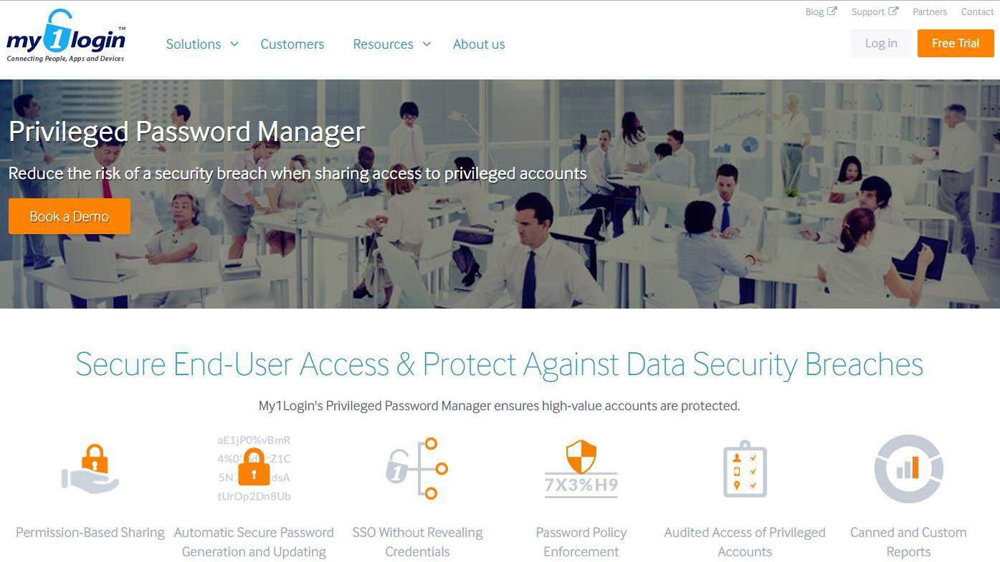
(4) Store Passwords Securely

Slide 16
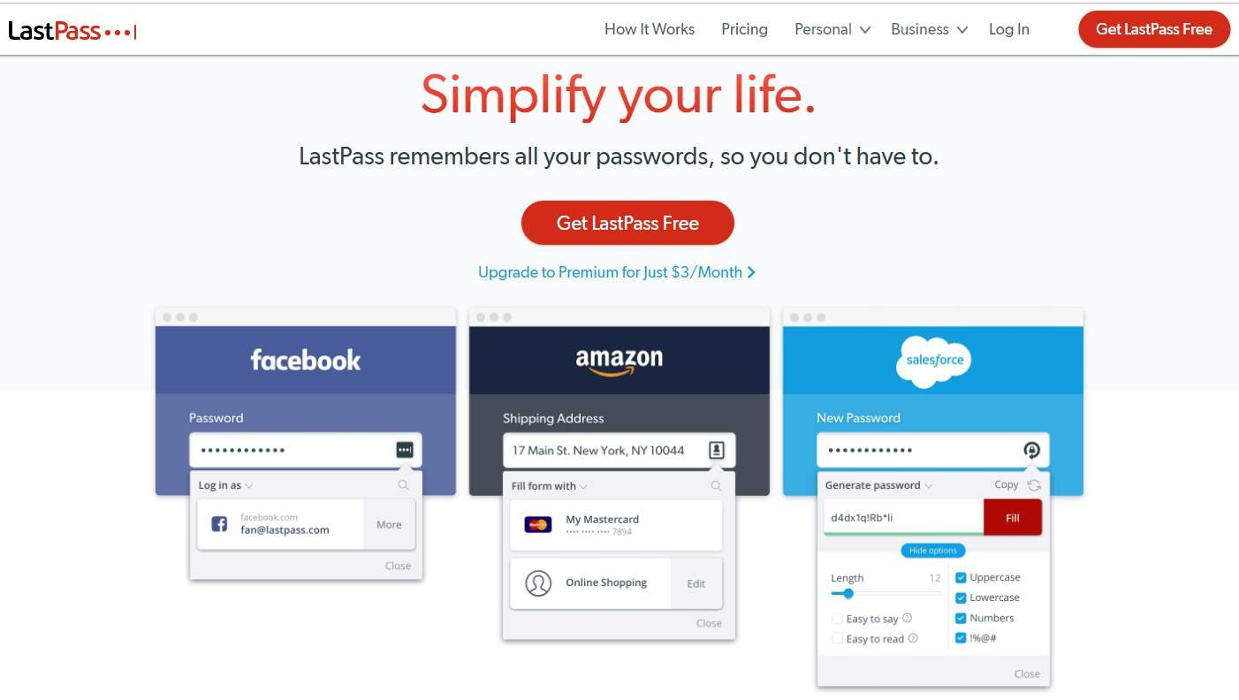
(4) Store Passwords Securely

Slide 17
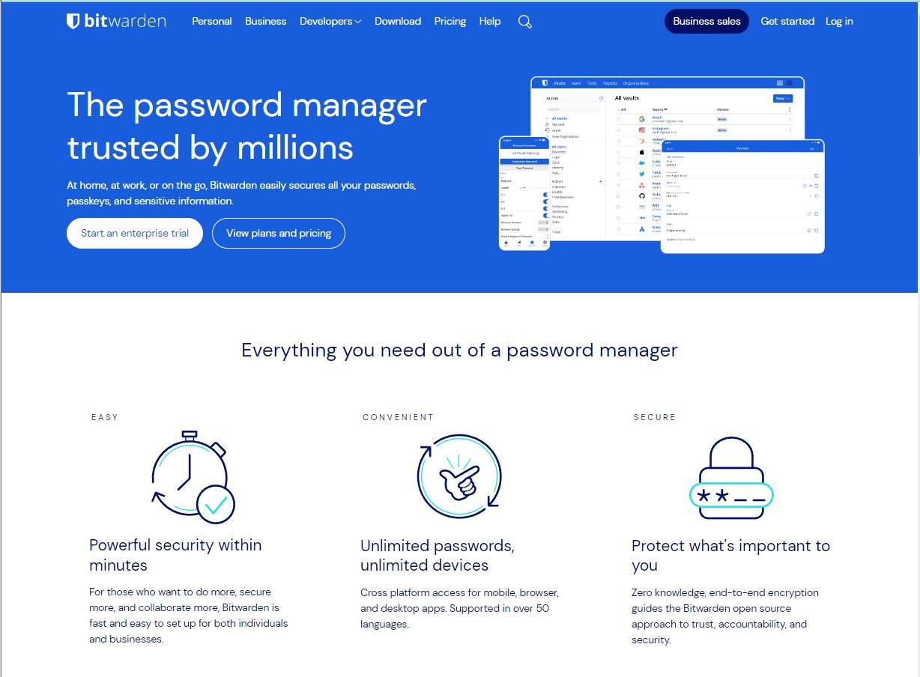
(4) Store Passwords Securely

Slide 18
(5) Test and Manage Your Backup
Cross your fingers (bad)
Have a Plan
Follow the Plan
Test the Plan

Slide 19
The Links
Virus Alerts
US Virus Alerts (CISA)
NJ Virus Alerts (NJCICC)
https://www.cisa.gov/news-events/cybersecurity-advisories/ https://www.cyber.nj.gov/threat-center/alerts-advisories/
Phishing & Social Engineering
https://haveibeenpwned.com/
Check Your Email Account https://haveibeenpwned.com/ https://haveibeenbreached.com/
Choose Safe Passwords
https://www.passwordmonster.com/
Store Passwords Securely https://www.my1login.com/ https://www.lastpass.com/ https://bitwarden.com/

